Slide 1

Distributing Goods through a Distribution Network
Ahmet Oral

Slide 2
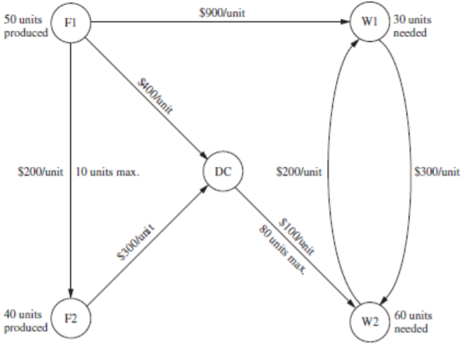
The Problem
Scheme:
The company will be producing same product in two factories.
There are 2 warehouses that needs spesific amount of units.
There is a Distribution Center which can pass the products into warehouses.
Every path costs a certain amount to move products.
There are some paths with limited moving capacity.

Slide 3
Model Formulation:
Set and Indices:
f ∈ Factories = {F1, F2}
d ∈ Distribution Centers= {DC}
W ∈ Warehouses = {C1, C2, C3, C4, C5, C6}
Locations = Factories ∪ D.Centers ∪ Warehouses
Parameters:
Cost(s,t) ∈ R+: Cost of shipping one unit from source s to destination t.
Supply(f) ∈ R+: Maximum possible supply from factory f (per unit).
Through(d) ∈ R+: Maximum possible flow through depot d (per unit).
Demand(w) ∈ R+: Demand for goods at warehouse w (per unit).

Slide 4
